Slide 1
DORM MANAGEMENT SYSTEM
By Ninjas

Slide 2
Contents
Abstract
Introduction
Advantages
System Design
Software Requirements
Functional Walkthrough
Conclusion
Reference

Slide 3
Abstract
“DORM MANAGEMENT SYSTEM ” is an online application developed form managing various activities of the dorm.
The project deals with problem on managing the dorm and avoid the problem which occurs when carried manually.
We can improve the efficiency of the system , thus overcome the drawback of existing system.

Slide 4
Introduction
Dorm management system provides customize and user friendly software for dorm information management.
It helps admin and Students to manage:-
Student Records
Room Records
Allocating Room
Finding Room Partner on the basis of Compatibility.

Slide 5
Advantages
Easy to handle
Authorized Users Based Roles
Easy Data Insert , Update and Retrieval
Less Human Error
Good Security

Slide 6
System Design
Data Flow Diagram Level 0
User
Dorm Management Database
Hostel

Slide 7
System Design
Data Flow Diagram Level 1
Dorm Management Database
Students
Admin
Application
Verification
Allotment
Confirmation

Slide 8
System Design
Data Flow Diagram Level 2
Dorm Management Database
Student
Signup/
Login
Student Application
Details
Admin Evaluation

Slide 9
System Design
Data Flow Diagram Level 2
Reapply
No
Admin
Login
Student Application
Evaluation
eligible
Yes
Dorm Management Database

Slide 10
Software Requirements
FRONTEND: HTML 5, CSS 3, Bootstrap, JavaScript
BACKEND: PHP
DATABASE : MySQL

Slide 11


WHY MySQL ?

Slide 12
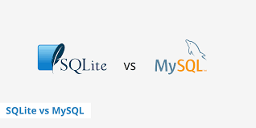
MySQL vs SQLite

Slide 13
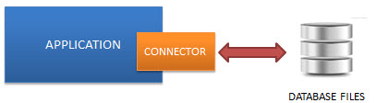
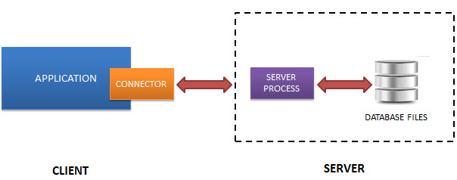
MySQL vs SQLite
SQLite is a self-contained, file-based database, and server-less database, while MySQL requires a server to set up and run.
SQLite is called an “embedded” database which means the DB engine runs as part of your app:
MySQL requires a client and a DB server to interact with each other over the network:

Slide 14
MySQL vs SQLite
Features | MySQL | SQLite
Supported Datatype | MySQL supports a lot more: TINYINT, SMALLINT, MEDIUMINT, INT, BIGINT, FLOAT, DOUBLE, DECIMAL, NUMERIC, DATE, DATETIME, TIMESTAMP, YEAR, CHAR, VARCHAR, TINYBLOB, TINYTEXT, BLOB, TEXT, MEDIUMBLOB, MEDIUMTEXT, LONGBLOB, LONGTEXT, ENUM, SET. | SQLite supports BLOB, NULL, INTEGER, TEXT, REAL.
Storage | The MySQL Server is around 600mb. | The SQLite library is around 250kb in size.
Scalability | MySQL can handle a lot of data and furthermore it can be used at scale. | SQLite requires too much memory to run if the database is big. Then it’s hard to optimize for the higher performance. It’s also one of the limitations of SQLite is the write operations.
Security and Authentication | A lot of security features, from basic as username and password to rather advanced as SSH, are built in MySQL. | SQLite does not provide an authentication system. The database file itself can be read and updated by anyone.
Concurrency | MySQL supports multiple users and can handle concurrent read/write operations. | Only one process can make changes to the database at any given time. Only concurrent read operation supported.
Exclusive Locking | MySQL doesn’t require exclusive locks for lengthy/multiple inserts. | For SQLite it was necessary to explicitly enable an exclusive lock during the length of the insert process.

Slide 15
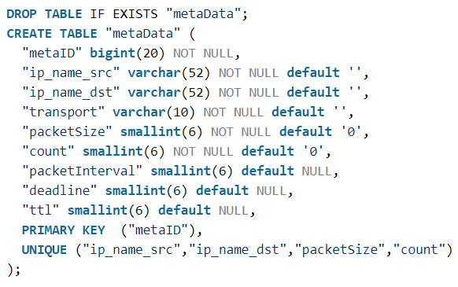
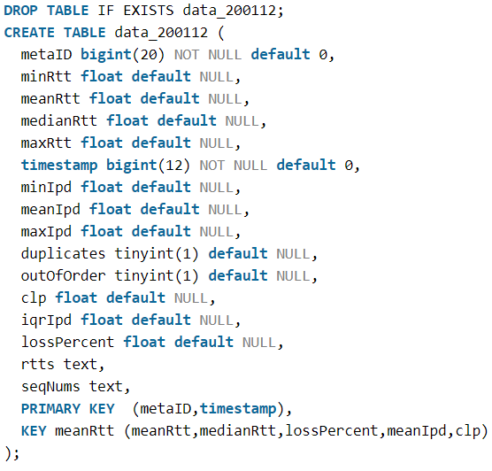
MySQL vs SQLite Performance Testing
To compare the performance of MySQL vs SQLite, a quick sample database was made based off of a previous PingER SQL database schema. Existing converted data was available based on PingER results from December, 2001.
DDL Test
MySQL table structure

Slide 16
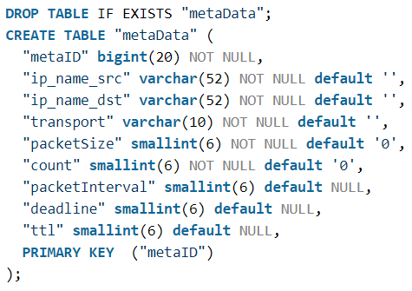
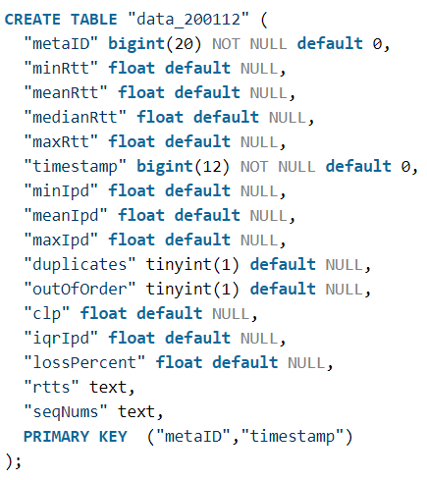
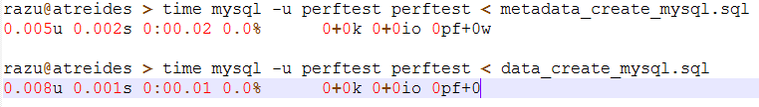
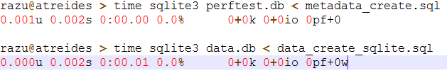
MySQL vs SQLite Performance Testing
SQLite table structure

Slide 17
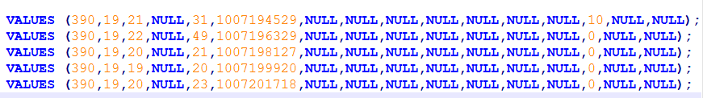
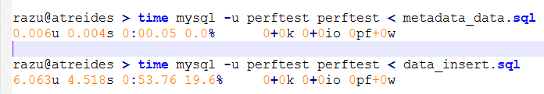
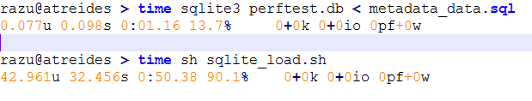
MySQL vs SQLite Performance Testing
DML Testing 210 rows were inserted into the metaData table and 325,720 rows were inserted into the data_200112 table. The sample data consists of a month's worth of PingER results from 22 sources to between 4 and 9 destinations.
Sample insert data for data_200112 table

Slide 18
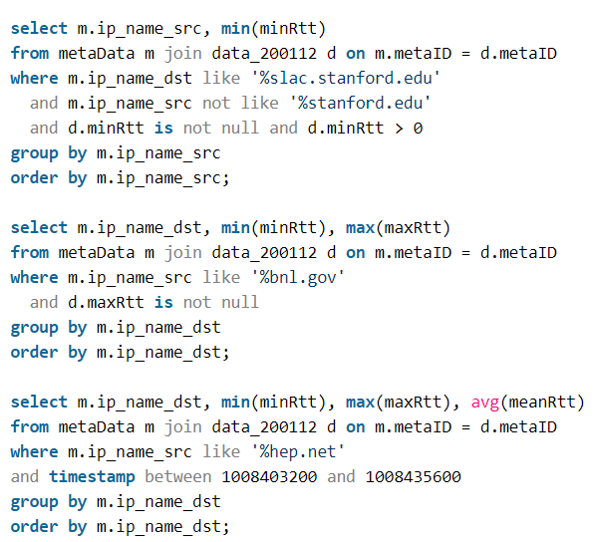
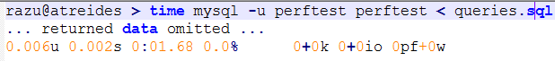
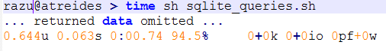
MySQL vs SQLite Performance Testing
Query timing

Slide 19
MySQL vs SQLite Performance Testing Summary
SQLite performs at the same or better speed vs. MySQL when dealing with "single-threaded" activity, i.e. only one process reading and writing to the database.
SQLite's locking must be taken into account when inserting into a table.

Slide 20
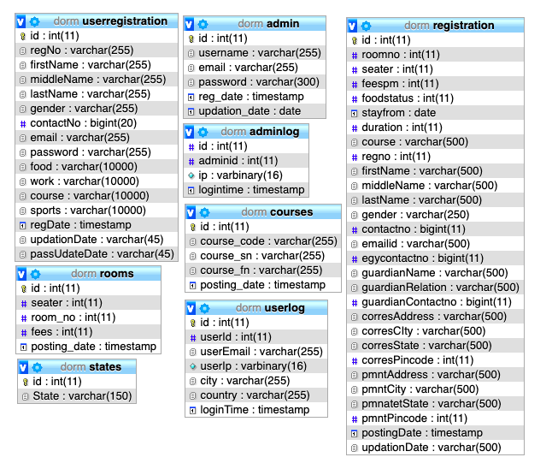
Database Design

Slide 21
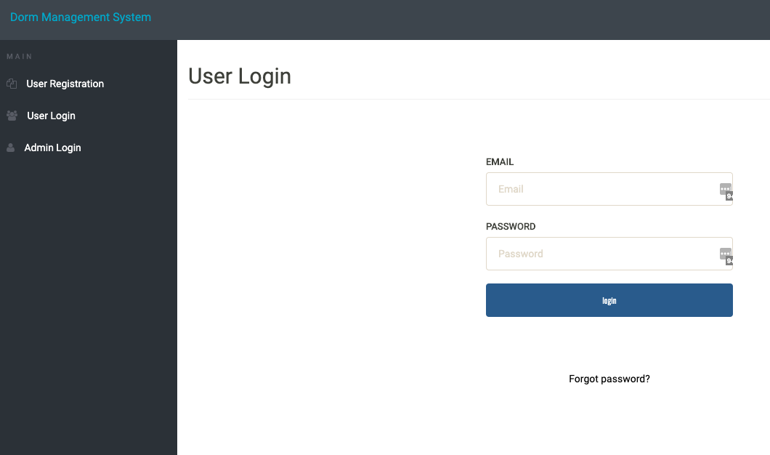
Website Layout

Slide 22
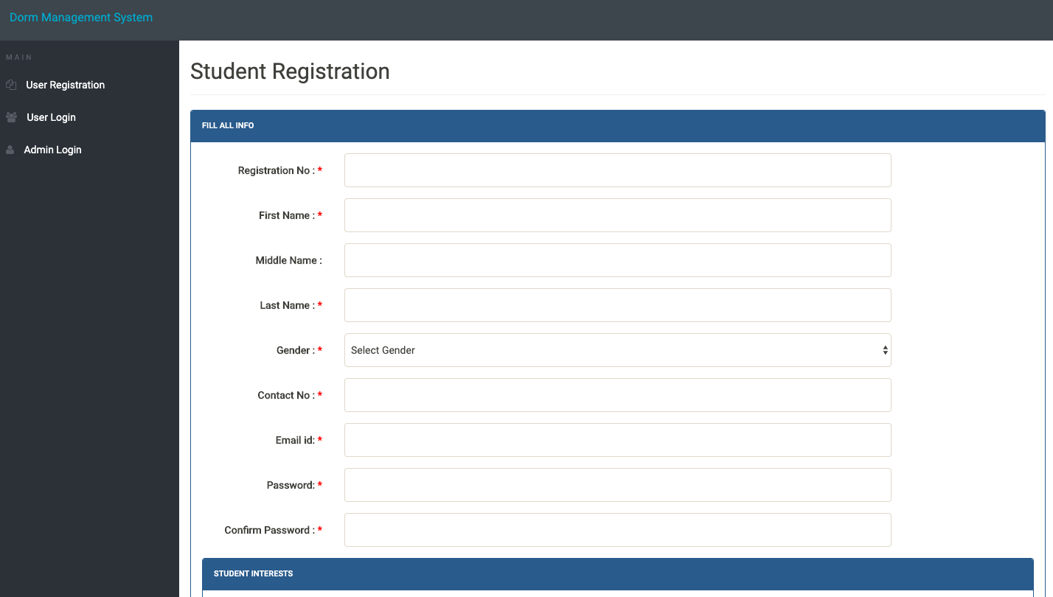
Student Registration

Slide 23
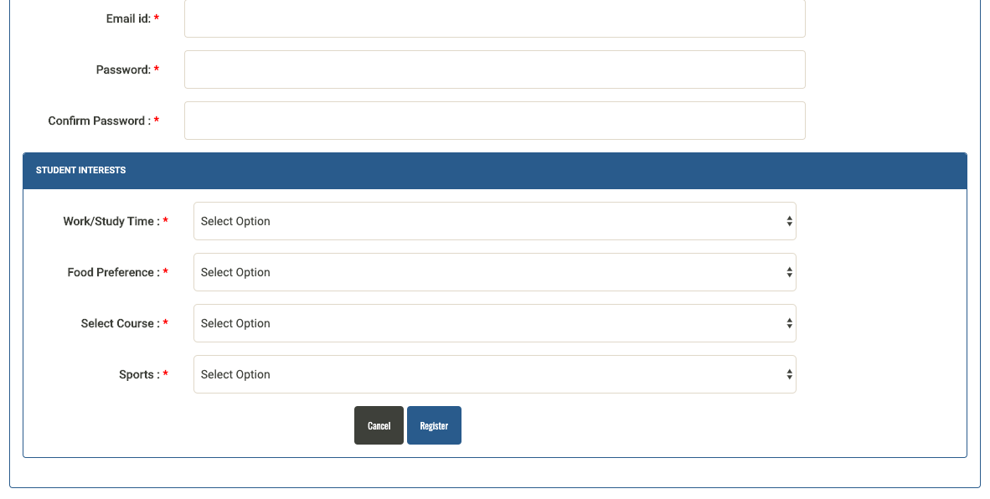
Student Registration

Slide 24
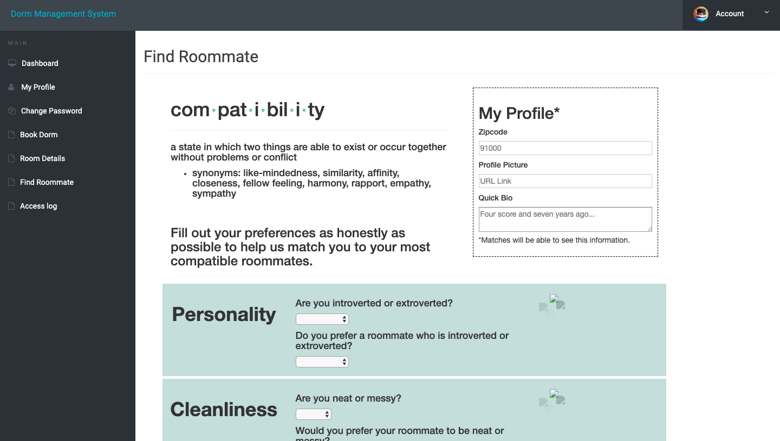
Roommate Finder

Slide 25
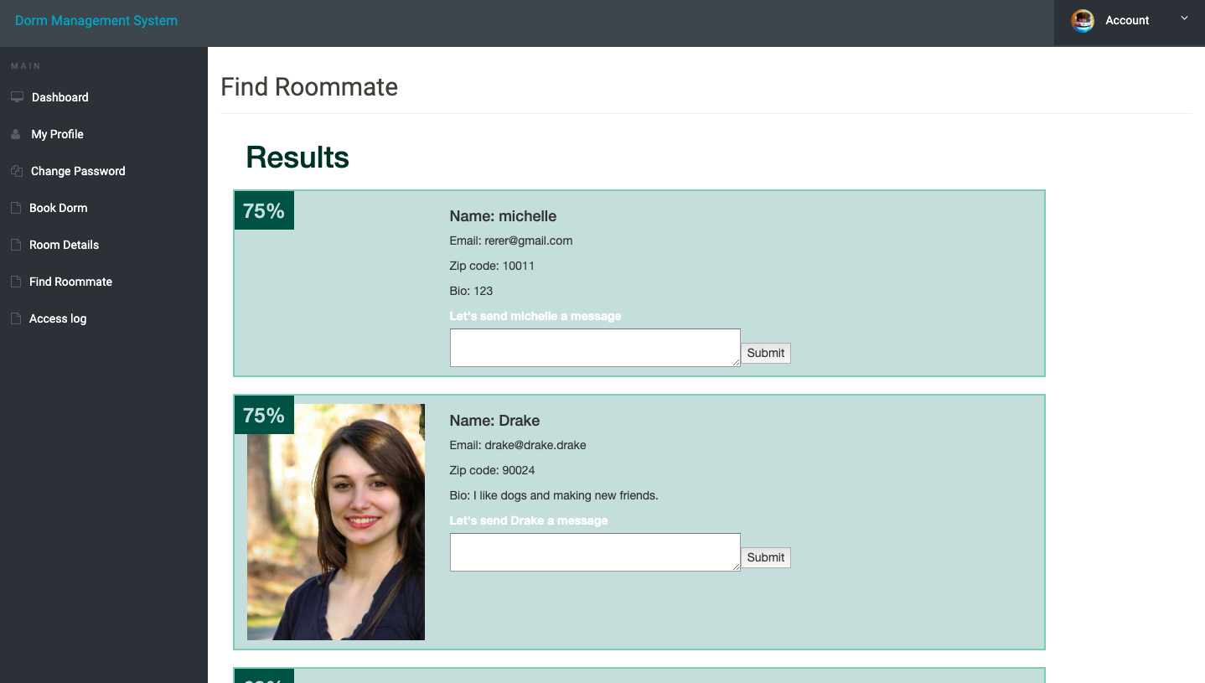
Roommate Finder

Slide 26
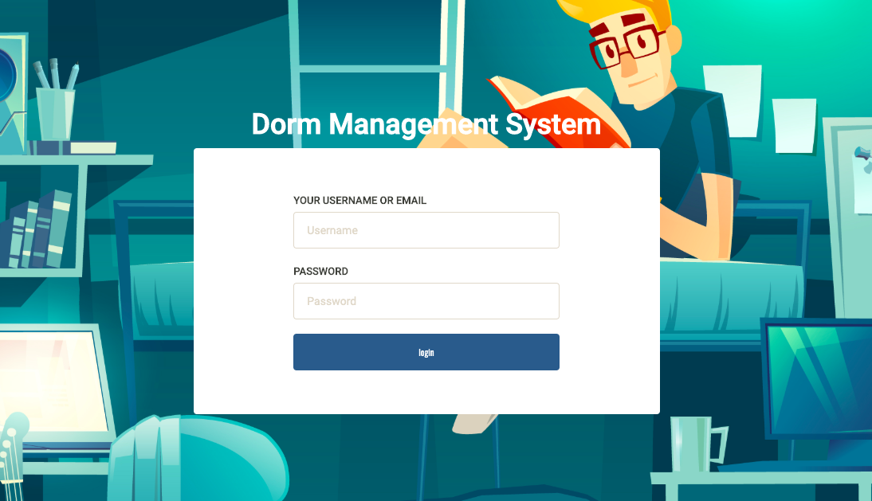
Admin Panel

Slide 27
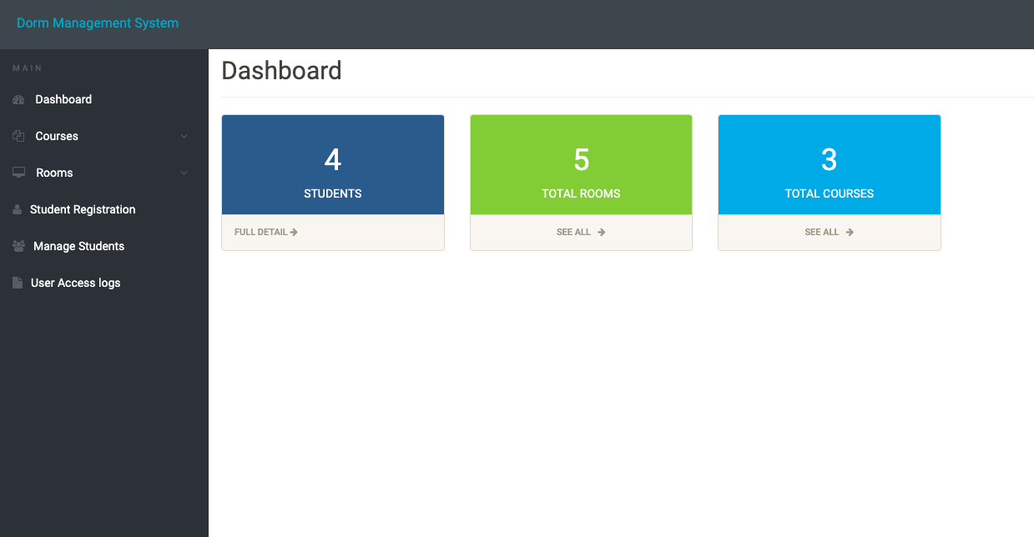
Admin Panel

Slide 28
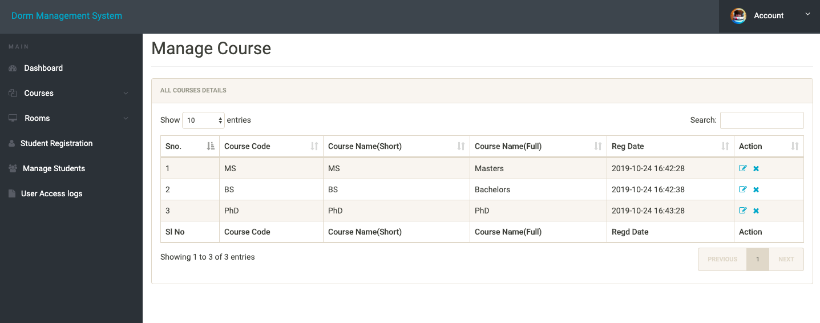
Admin Panel

Slide 29
References
https://www.sqlite.org/whentouse.html
https://tableplus.com/blog/2018/08/sqlite-vs-mysql-which-database-should-you-use.html

Slide 30
LIVE DEMO!

